Slide 1







Slide 2

EVALUATING AND GROWING DMM MINISTRY
THROUGH COACHING SKILLS

Slide 3

Good coaching enhances
a culture of evaluation.
The problem:
Misperceptions about coaching often adds undo pressure on leaders to feel they need to know all the answers - which short-circuits discovery and the dependence on the Spirit.
Notes:
SOLUTION: This session aligns basic coaching skills with principles & values critical for movements.
It gives a practical introduction to a DMM coaching tool,
and outlines an opportunity to grow as life-long-learners of Jesus.
3 MIN

Slide 4
WHAT IS COACHING?
Notes:
INSERT THE WORDS IN THE CHAT BOX

Slide 5
WHAT IS COACHING?
Prayerfully asking insightful questions of self-discovery to move others toward
a desired outcome.

Slide 6

COACHING IS NOT
Telling
Counseling
Advice giving or problem solving
Making comparisons with others
Consulting or mentoring
Notes:
What coaching is not [1 minute]
Not telling – this disempowers the catalyst.
Not counselling – coaching looks at the present and the future.
Not advice-giving or problem-solving – coaching asks questions, not delivers answers.
Not making comparisons with others – you are in a unique context which needs unique solutions and ideas.
Not consulting or mentoring – a coach does not give information or expert advice.

Slide 7

WHAT COACHING DOES
Generates responsibility
Raises awareness
Facilitates change
Affirms strengths
Focuses on the future
Develops a growth mindset
Notes:
Raises awareness – “Wow! I never thought of it like that!”
Generates responsibility – “What can I do to change the situation?”
Facilitates change – “Step by step, I can create a new habit that brings a different outcome.”
Affirms strengths – “I am good at this. Knowing this brings me energy.”
Develops a growth mindset – “I am developing my skills.” Rather than a fixed mindset which says, “I’m not good at this.”
Focuses on the future – “I can see a vision of what I desire.”

Slide 8

TELLING VS COACHING

Slide 9
DMMLAND STORY

Slide 10
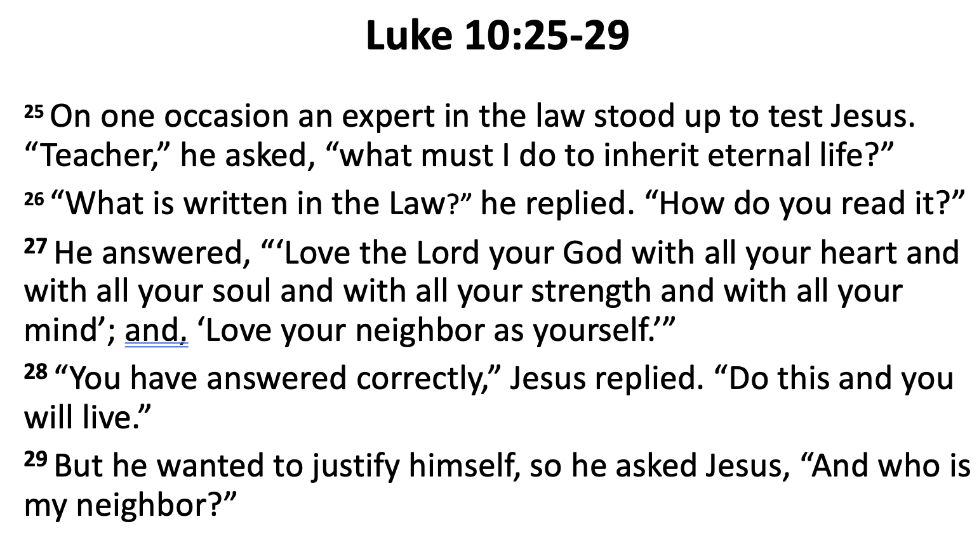
PRAYER
CREATE GOALS
DEVELOP STRATEGY
“I WILL” STATEMENTS
Notes:
THIRD step is to see what is currently happening and to think about the current LEAD and LAG indicators of your team.
1 min.

Slide 11

GROUP DISCOVERY
Luke 10:25-29
1). How many questions are asked in these 5 verses?
2). Discuss why you think Jesus asked a question
instead of telling the lawyer the answer.
3). When the lawyer asked another question what did Jesus do next in verses 30-37? What can we learn from Jesus’ example?
Notes:
SPEND TIME IN YOUR GROUP FOR 5 MINUTES LISTING SOME OF THE IMPORTANT QUESTIONS JESUS ASKED, WHOM HE ASKED AND WHAT WAS HIS IN TENT IN ASKING
5 min._ 3 min = 8 MIN

Slide 12
GROUP DISCOVERY
The question Jesus asks | Whom Jesus asks | Jesus' Intent
Example: Who do you say I am? | the twelve | Let them discover and articulate what Jesus’ identity is
Example: Whose image and inscription are on a Denarius? | scribes + chief priests | Realize it is Caesar’s, and Caesar thus is owed taxes

Slide 13

SUBTITLE: The 307 Questions JESUS ASKED & the 3 That He answered
Notes:
A BOOK I READ SEVERAL YEARS AGO: HAS THE TITLE: JESUS IS THE QUESTION (COVERING UP JESUS IS THE ANSWER)
THE SUBTITLE OF THE BOOK IS THE 307 QUESTIONS JESUS ASKED & THE 3 THAT HE ANSWERED
Jesus was asked 183 of which he only answers 3 –and YET HE SET AN EXAMPLE THAT HE ASKED 307 Questions almost twice what he was asked.
I WOULD PROPOSE TO YOU THAT JESUS WAS A MASTER TEACH PRIMARILY BECAUSE HE KNEW HOW TO ASK GOOD QUESTIONS
(AND TELL GOOD STORIES)! 3MIN

Slide 14
COACHING
INVITE
GOAL
REALITY
OPTIONS
WILL DO

Slide 15
INVITE IN iGROW
HELLO, HOW ARE YOU?

Slide 16
GOAL IN iGROW
WHAT YOU WANT TO SEE HAPPEN

Slide 17
REALITY IN iGROW
WHAT YOU ARE DOING AND WHAT YOU HAVE DONE

Slide 18
OPTIONS IN iGROW
WHAT YOU COULD DO

Slide 19
WILL DO IN iGROW
WHAT YOU COMMIT TO DO

Slide 20
Similarities
Discovery Bible Study
INVITE
GOAL
REALITY
OPTIONS
WILL DO
Review– Discussion of What are you thankful for? Struggling with?
Scripture chosen to Grow as Disciple
Learning about God & People
Ways it Apply in our lives
I Will statements
Notes:
This iGROW COACHING TOOL is designed to help you get out of the way, ASK INSIGHTFUL QUESTIONS and allow the Holy Spirit to lead a great EVALUATION CONVERSATION>
2 min

Slide 21
INVITE IN iGROW

Slide 22
INSIGHTFUL QUESTIONS
TO LAUNCH INVITE

Slide 23
What are a few reasons for you to be thankful?
What is big in your life at the moment?
What have you been learning recently?

Slide 24
INVITE GOD

Slide 25
BUILDING RAPPORT

Slide 26
PREPARING YOUR INNER WORLD

Slide 27
What am I feeling right now?
What do I want to lay down? (a burden or negative thought)
What can I be grateful for today?
What are my 2 positive words for this coaching session? (for example: calm and alert)

Slide 28
MIRRORING

Slide 29
What gives you joy at the moment in ministry?
What is the overall vision you desire to become reality?
What priorities do you see in your ministry in the next 3 months?

Slide 30
ENGAGED LISTENING

Slide 31
Use some of the following questions to practice engaged listening through questions that build a positive atmosphere and empower the other. By empowering we mean, a state of ‘I can do this!’
What have you loved about the last 6 months?
What have you achieved or accomplished in the last 6 months?
What have you done that you would like to do again?
What are some of the empowering decisions that you made in the last 6 months?
What is one thing you found extremely difficult at the time that you have achieved?
How do you feel now having thought about these empowering areas?

Slide 32
GOAL IN iGROW

Slide 33
INSIGHTFUL QUESTIONS
TO LAUNCH GOAL

Slide 34
What would you like to work on today?
What would make our time together valuable to you?
What would you like to take away from this conversation?
What would you like to evaluate today?
What are the benefits to seeing this happen?
What do you hope to accomplish by the end of our time together?
How would you state in one sentence what you want to see happen?

Slide 35
PASSION:
WHAT TOUCHES YOUR EMOTIONS?

Slide 36
ENERGY:
WHAT IS EXCITING TO DO AND FEEDS YOUR JOY?

Slide 37
FULFILLMENT:
WHAT BRINGS YOU MOST SATISFACTION?

Slide 38
CONTRIBUTION:
YOUR PART IN CHANGING THE WORLD FOR THE BETTER?

Slide 39
REGRETS:
ANTICIPATING WHAT YOU DO NOT WANT TO HAPPEN MOTIVATES US.

Slide 40
HOW TO EVALUATE THE GOALS SET ACCORDING TO VISION AND VALUES

Slide 41
How important is it to you to reach this GOAL?
What goes on inside of you when you think about reaching this GOAL?
How enthusiastic are you about this GOAL?
What could you do to increase your confidence about this GOAL?
What would need to change to make this goal more desirable?
How well is this value reflected in your ministry right now?

Slide 42
REALITY IN iGROW

Slide 43
INSIGHTFUL QUESTIONS
TO LAUNCH REALITY

Slide 44
Where is God most powerfully at work and we need to be joining Him more in what He is doing?
Where is healthy spiritual DNA displayed and transferred most strongly that we can celebrate?
Where are deficiencies of healthy spiritual DNA that need addressing?
Where is mission drift happening that needs course-correcting?

Slide 45
BROAD QUESTIONS
Where is God most powerfully at work and we
need to keep joining Him in what He is doing?
Where is healthy spiritual DNA especially
displayed and transferred that we can celebrate?
Where are deficiencies of healthy spiritual DNA that need addressing?
Where is mission drift happening that needs course-correcting?
Notes:
As you think back about the ratings assigned to each category now talk about the Highs to celebrate or the Lows to course correct.
1 MIN

Slide 46
DMM EVALUATION QUESTIONS

Slide 47
REALITY - DMM EVALUATION QUESTIONS:
PRAYER: How abundant is prayer and fasting?
COMPASSION MINISTRY: How well is compassion & authentic relationships
received in the community?
PERSONS OF PEACE: How well have people of peace been found & mentored?
DISCOVERY GROUPS: How well have new discovery groups started & multiplied?
OBEDIENCE: How obedience-focused has the disciple-making been?
CHURCH GATHERINGS: How well does the community life model a kingdom lifestyle?
DISCIPLE REPLICATION: How well have disciples been replicated?
LEADER DEVELOPMENT: How well are indigenous leaders being developed?
CHURCHES REPRODUCING: How well are churches being multiplied?
EVALUATION: How well are shepherds coached to evaluate their churches?
Notes:
THIS PARTICULAR TOOL has you look at the HIGHs and LOWs of your engagement to DECIDE what to focus on in the session.
PASS OUT HANDOUT
PRAYER, Compassion ministry & authentic relationships, PoP, DGs, Obedience, Churches formed, disciples replicated, leaders developed, churches reproducing & Evaluation
3 MIN

Slide 48
ANGLES TO GAIN A 360 VIEW OF A SITUATION

Slide 49
QUESTIONS – 360º View
GOD – What does God’s word say, or what has God spoken
in the past that might be relevant for this situation?
FACTORS – What are the factors that led up to this
situation?
EXAMPLES What have you tried already, and what difference
have these attempts made?
FEELINGS - What are the relational dynamics at play in this
situation?
Notes:
As you think back about the ratings assigned to each category now talk about the Highs to celebrate or the Lows to course correct.
1 MIN

Slide 50
OPTIONS IN iGROW

Slide 51
INSIGHTFUL QUESTIONS
TO LAUNCH OPTIONS

Slide 52
What would help you move forward?
What are ways forward toward your desirable GOAL?
What needs to be done to take this forward?
How can you bridge the gap between the present situation and the desirable future?

Slide 53
OPTIONS TO EXPLORE WAYS FORWARD

Slide 54
INSIGHTFUL QUESTIONS FOR RESOURCES

Slide 55
What are the resources needed?
How can you mobilize these resources?
What competencies are needed to take this forward?
Who are the people who have these competencies?
What are the materials needed?
What are the finances needed?
What is the unique contribution you can make to address this?
How much personal capacity will you have to work on this?
How does your family situation need to be considered?

Slide 56
WILL DO IN iGROW

Slide 57
INSIGHTFUL QUESTIONS
TO LAUNCH WILL DO

Slide 58
How do these insights above inform your strategy
for the next few months?
What are a few specific steps that you want to take to move toward your desirable GOAL?
If you were to pray for one thing, what will that be?
What are the specific steps you are committing to take until we talk next time? [in a quarterly evaluation conversation: in the next three months]

Slide 59
THREE R’s TO ACTION

Slide 60
RANK
RECORD
RATE

Slide 61
RANK
RECORD
RATE

Slide 62
RANK
RECORD
RATE

Slide 63


Slide 64
CHECKLISTS FOR iGROW COACHES

Slide 65
WHO WILL I BE COACHING?

Slide 66
HOW TO PREPARE FOR A COACHING SESSION

